Slide 1

MODELLING Reverse Mortgages
原文作者: Y.K.Tse, 1995, ASIA PACIFIC JOURNAL OF MANAGEMENT
0253924 張錦炘

Slide 2
outline
Characteristics of Reverse Mortgages
Analysis of Reverse Mortgages

Slide 3
REview
Reverse mortgage is designed to allow older people to borrow by using the equity in their home as collateral.
A reverse mortgage means borrowing money against the value of the property. The homeowner receives the monthly loan, or annuity, based on the value of his property.
The amounts borrowed accumulate with interest until the mortgage's due date or the death of the homeowner.

Slide 4
Characteristics

Slide 5
Characteristics
If the economy grows and the property appreciates in value over the years, the homeowner would have a more valuable asset against which to continue taking the loan. The lender would also benefit from the property's appreciation as it would reduce the possibility of the accumulated debt exceeding the value of the property.

Slide 6
Characteristics
In a reverse mortgage, the lender makes a loan to the homeowner, usually in the form of monthly annuity payments. The loaned amount accumulates with interest until the due date. Then repayment is made, usually through the proceeds obtained from the sale of the property.
The terms of a reverse mortgage can be classified into three types: fixed-term, split-term and tenure.

Slide 7
 | Period of month loans | repayment
fixed-term | fixed | at the end of the term
split-term | fixed | until the homeowner dies or moves out of the home
tenure | as long as the homeowner lives in the home | until the homeowner dies or moves out of the home

Slide 8
While tenure reverse mortgage is the most popular among homeowners, the underlying guarantees shift the risks to the lender. Basically, the guarantees are of the following nature:
First, the residency guarantee ensures that the homeowner need not move out of the home even if the accumulated loan exceeds the value of the property.
Second, the income guarantee requires the lender to make monthly loan payments as long as the homeowner lives in the home.
Third, the repayment guarantee specifies no repayment needs to be made as long as the homeowner lives in the home.
Fourth, the nonrecourse guarantee protects the homeowner's assets (other than the mortgaged property) from being seized by the lender to repay the loan.

Slide 9
To increase the amount of monthly loan payment so as to make the loan more attractive to homeowners, some lenders introduce the additional feature of shared appreciation. Under this scheme, the lender and the homeowner share, at a predetermined ratio, the appreciation of the mortgaged property.
For example, a 50/50 shared appreciation scheme requires the homeowner, upon selling the mortgaged property, to pay 50 percent of the increase in value of the property, net of closing costs, to the lender before repaying the loan balance. Thus, by giving away part of the potential future appreciation, the homeowner receives larger amounts of monthly loan payment.

Slide 10
Loaded with various guarantees and uncertainties about the interest rate, property appreciation rate and mortality rate, the evaluation of reverse mortgage requires a proper assessment of the interaction of these factors.
In the next section we provide a framework for analyzing a tenure reverse mortgage. Also present analysis based on Singapore data in a fixed interest rate environment as well as a stochastic interest rate environment.

Slide 11
Analysis

Slide 12
We consider a tenure reverse mortgage. The mortgage is assumed to be taken up by either a single male, a single female or a married couple. For the last case, the repayment is made upon the death or moving-out of the last survivor.
In our illustrations we assume all mortgagors are aged 60.
Although repayment may be initiated when the homeowner moves out of the home for various reasons, for expositive purposes we assume moving-out does not occur.
As explained below, moving-out can be accommodated by adjusting the mortality table.

Slide 13
When the mortgage is originated, the mortgagor pays an origination fee to cover the necessary administrative charges. We assume that this fee amounts to 1% of the appraised value of the property and denote this rate by f.
Upon the sale of the property, transaction costs have to be deducted before the proceeds can be distributed to the lender. We assume the costs of sale amount to 3.5% of the selling price of the property and denote this rate by c.
We do not include a component to take account of the recurrent administrative expenses. This component can be incorporated by adjusting the origination fee.

Slide 14
Although death is a random process that occurs in continuous time, some simplification is required in the analysis. To this effect, we assume death occurs in the middle of the year. Sale of the property is initiated one month later (when the price of the property is agreed) and completed after a further three-month period.
For expositive purposes it is convenient to assume that both the date of birth and the date of origination of the reverse mortgage occurs on January 1. Thus, death occurs on June 30, sale occurs on July 31 and repayments are made on October 31.
Our illustration is based on an appraised property value of $250,000, denoted by P.

Slide 15
The analysis requires the following assumptions regarding the parameters of the model: appreciation rate, mortality rate and interest rate.
First, the proceeds available for repaying the loan depend on the rate of appreciation of the property. Estimates of the appreciation rate are, however, imprecise and vary with the types and locations of the property. Phang (1992) reported the average rate of appreciation for a 4-room Housing Development Board (HDB) apartment to be approximately 14% per annum for the period 1979 to 1987.
This figure is high compared to property appreciation rates in developed countries. Due to the fact that older people may not have the proper incentive to upkeep their property, it is appropriate to adjust the appreciation rate downwards. Thus, we consider five scenarios of the appreciation rate, with values of 6, 7, 8, 9 and 10%, and denote this rate by a.
These values are assumed to be the long-run average appreciation rates. No attempt is made to model the year-to-year fluctuations.

Slide 16
Second, another major uncertainty in modelling reverse mortgages comes from mortality. Due to the lack of a pension market in Singapore, the mortality experience of annuitants is unsufficient. In the following analysis, we use the Standard Life Table of Singapore (1983/88 (ORD)). We use the standard table with no adjustments in order to facilitate the replication of results and future comparisons.
However, it is noted that if adverse selection is prevalent, the use of a mortality table for the general insured population may overstate the mortality of the annuitants. On the other hand, to reflect the incidents of move-out, a multiplicative adjustment factor may be used. The fact that we do not correct for move-out leads to understated "mortality" rates.
Thus, the two omissions work in opposite directions. In the present situation of lack of experience and bearing in mind that the results are for illustrative purposes, this do-nothing approach is perhaps appropriate. Finally, to calculate the mortality rate of joint lives, we assume that events of death are independent in probability.

Slide 17
Third, the accumulation of loan balance depends on interest rate assumptions. Unlike property appreciation rates, the structure of interest rate behavior is well documented. We distinguish between the following rates of interest: (i) cost of fund, denoted by r; (ii) discount rate for the loan and repayment cash flows, denoted by y; and (iii) charged interest rate at which the loan balance accumulates, denoted by i.
The cost of fund is represented by the risk-free short-term rate of interest and is determined by model assumptions. The discount rate reflects the risks commensurate with future repayments, while the charged interest rate reflects the necessary profit margin on top of the risks undertaken. In the following illustration, we assume y = r + 0.01 and i = r + 0.02.
All interest rates are assumed to compound monthly.

Slide 18
We consider the following interest rate environments: fixed interest rate environment and variable interest rate environment. In the fixed interest rate environment we use the long-run average to represent all future interest rates. Thus; in particular, i remains unchanged for the term of the reverse mortgage. Using the results reported in Tse (1994) we assume r = 0.06.

Slide 19
f | Origination fee
c | Transaction cost
p | Property value
a | Appreciation rate
r | Cost of fund
y | Discount rate
i | Charged interest rate

Slide 20
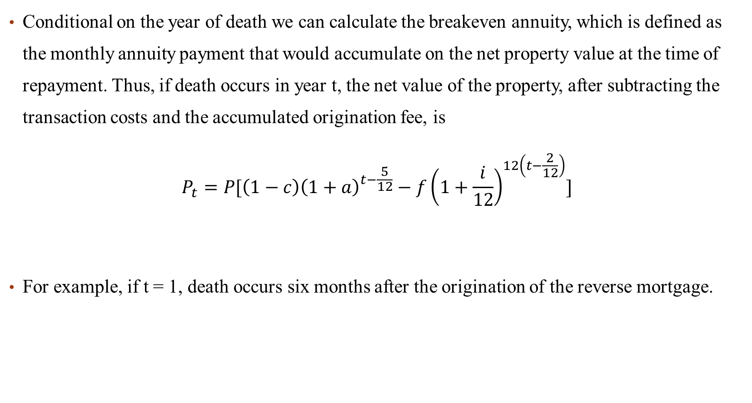

Slide 21
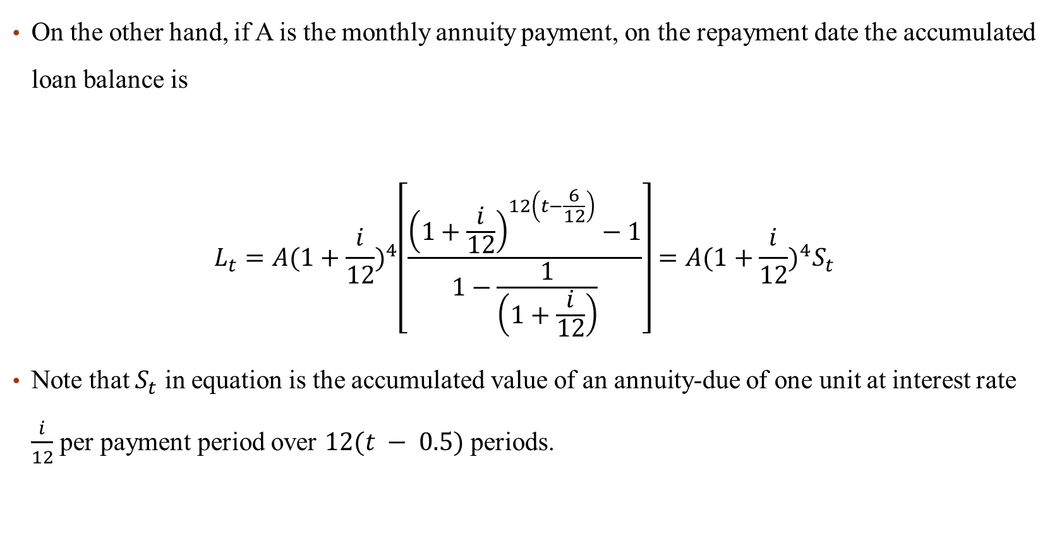

Slide 22
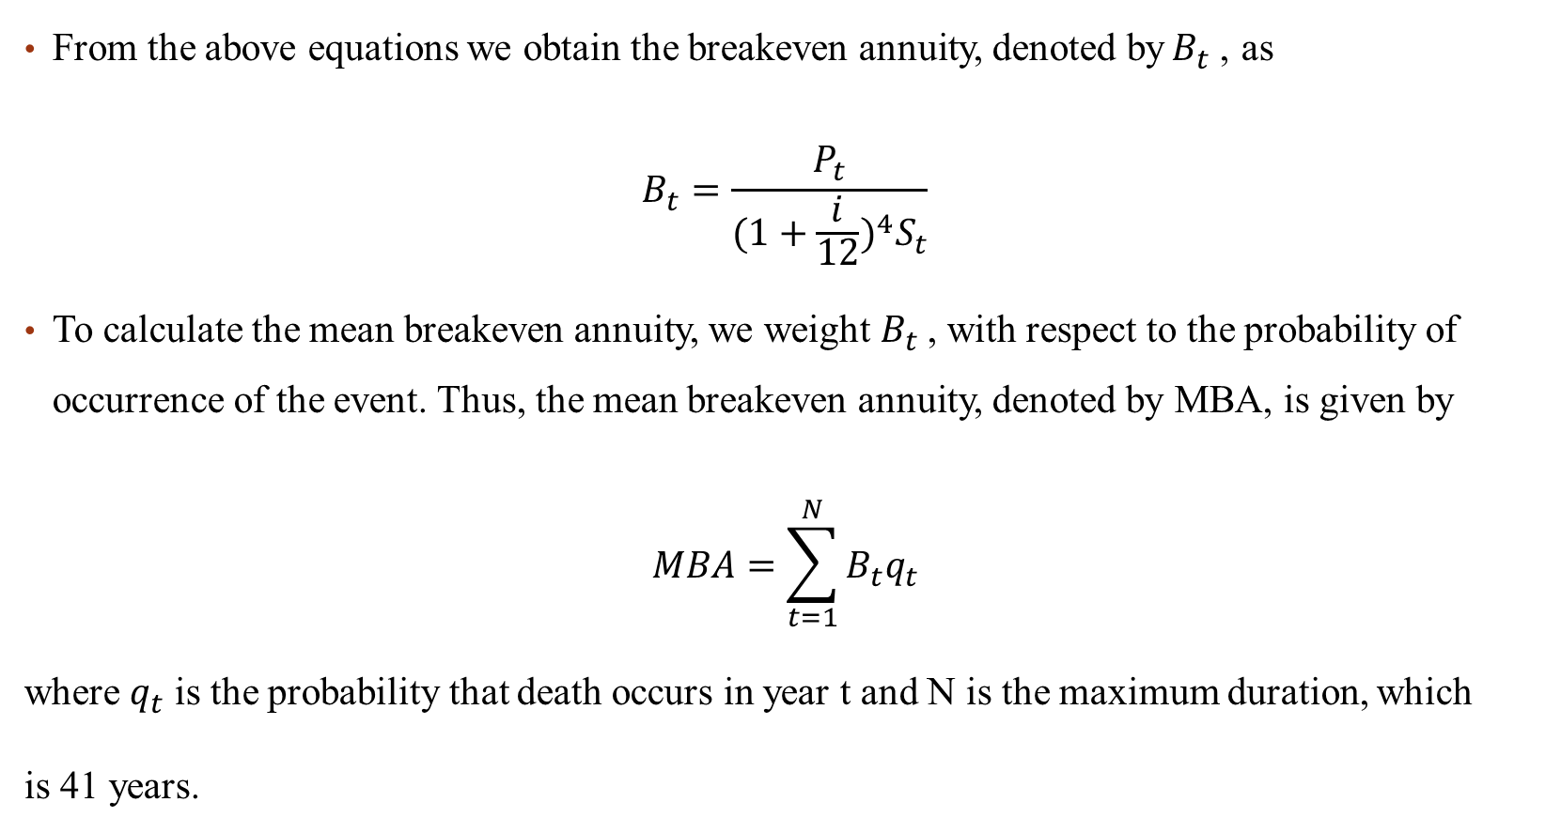

Slide 23
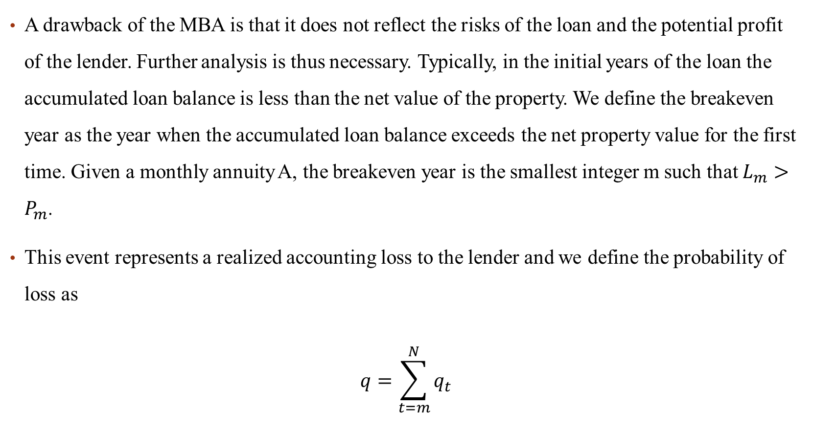

Slide 24
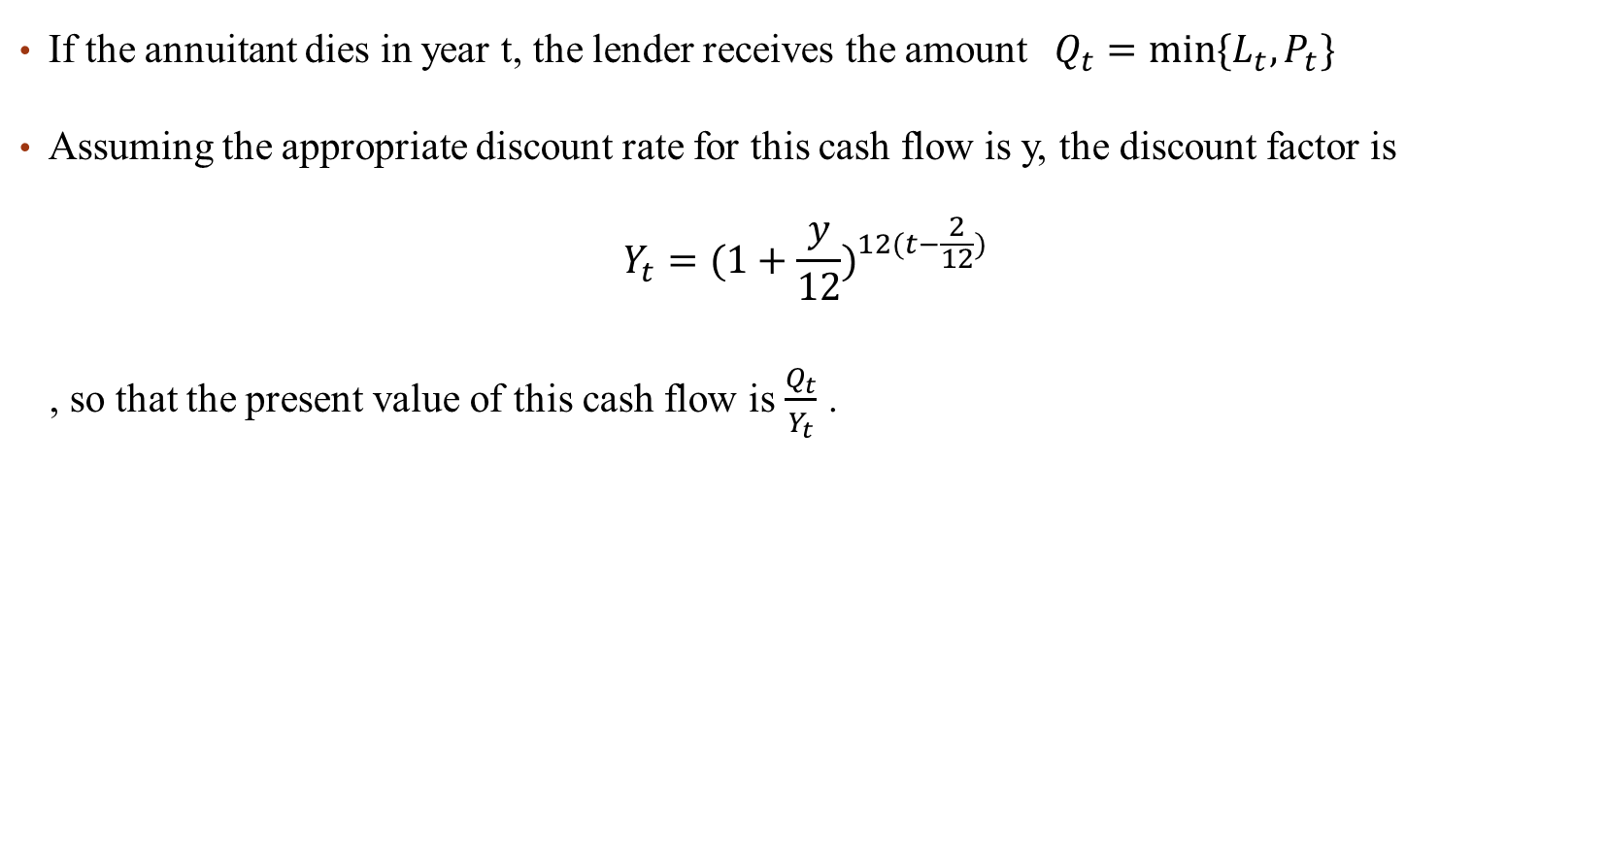

Slide 25
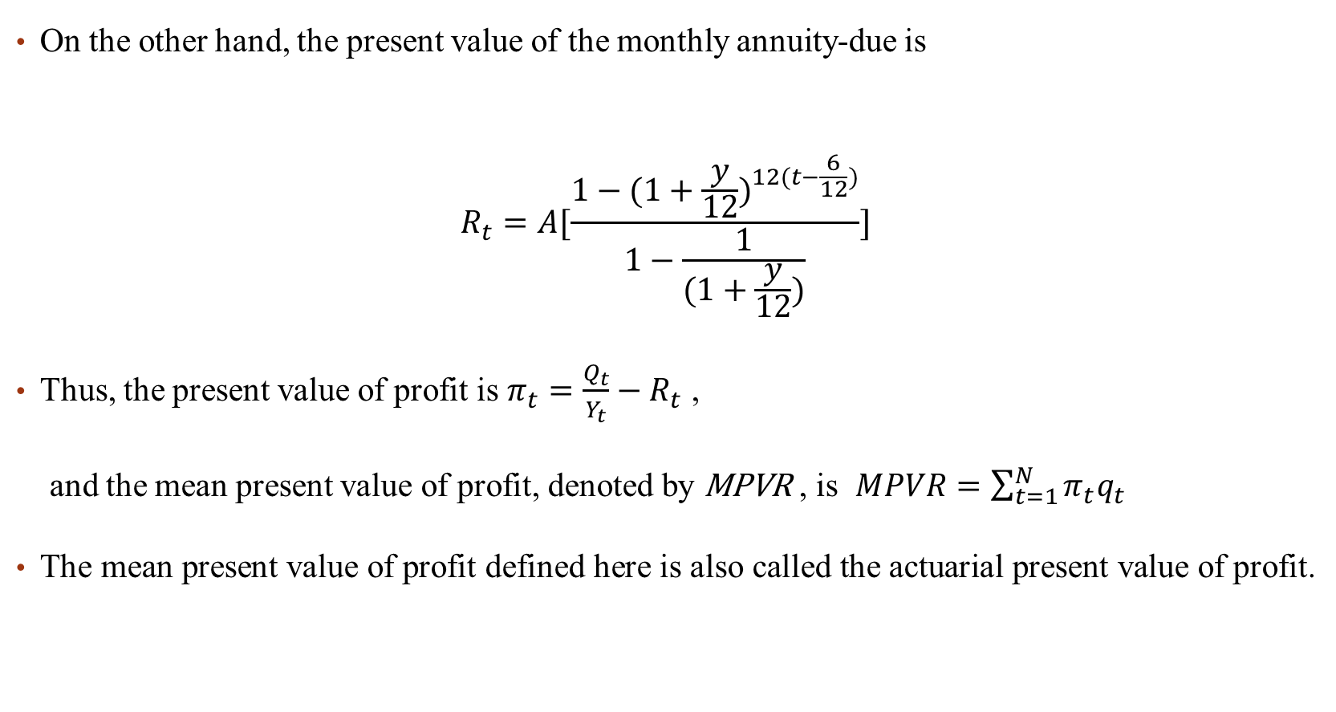

次方項應更正為
$$−12(t−\frac{6}{12})$$

Slide 26
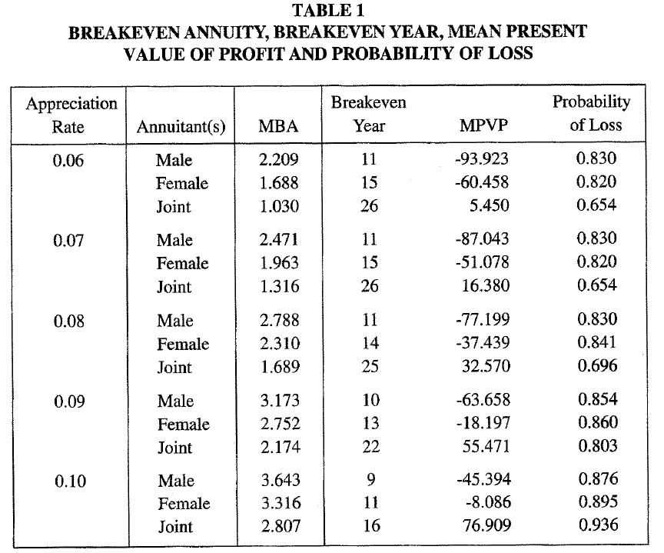
Note:
MBA = mean breakeven annuity,
MPVP = mean present value of profit.
Monetary values are in thousand dollars.
Initial property value is $250,000.
All annuitants are aged 60.
The charged interest rate is 8%
and the discount rate is 7%.

Slide 27
Table 1 summarizes the results in the fixed interest rate environment under various property appreciation scenarios. The breakeven year, MPVP and probability of loss are then evaluated at the MBA.
It can be seen that the reported MBA values are quite large and are likely to be attractive to potential borrowers. Indeed all reported values of MBA are larger than one thousand, with the minimum being the annuity for joint annuitants based on a property appreciation rate of 0.06.
The breakeven years for single-life annuities are, however, quite low, leading to negative MPVP.
Overall, it is highly likely that the accumulated loan balance is higher than the net value of the property at the time of death. In the case of joint-life annuities, the lender is expected to earn a positive net present value on average, despite the high probability of accounting loss.

Slide 28
END

